Slide 1
Simulation Activity: Yield and cost based on allocation of HTS resources
IAS 2018
Amsterdam, Netherlands
July 25th, 2018

Slide 2
Simulation objectives
Objectives:
HTS program success should be measured by the number of HIV-infected people identified and linked to treatment (or HIV-negative people linked to prevention services), and the % of people knowing their status, rather than the absolute number of HIV tests conducted
Selecting more cost-effective (loosely used) strategy will result in a much lower total cost
Key populations and high-prevalence groups should be prioritized, but due to smaller population sizes it likely will not be possible to reach targets and epidemiological control through prioritizing these groups alone generalized epidemics
While cost-effectiveness should drive the development of the strategy, there may be other considerations such as equity and access, that might affect program decisions

Slide 3
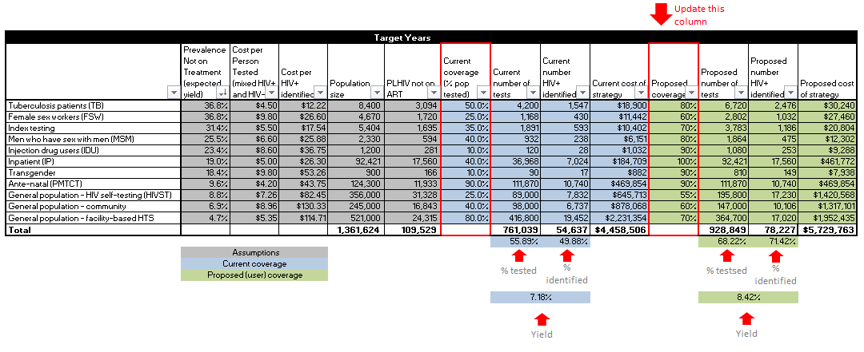
Overview of the exercise
Update the ‘proposed coverage’ to design your testing strategy

Slide 4
Overview of the outputs
8.27%
10.47%
HIV+
HIV+

Slide 5
Overview of the outputs
$65.50
Per HIV+ identified
$56.30
Per HIV+ identified

Slide 6
Instructions
Break into groups of roughly equal size
Each group will be assigned one scenario in either a low prevalence or a high prevalence settings
The objective will be to design a strategy that satisfies the criteria listed below:
  Minimize cost to identify 90% of PLHIV (First 90)
  Minimize cost to identify 50% of PLHIV (current allocation)
  Maximize number of people tested for HIV within the current budget
  Maximize number of PLHIV identified within the current budget
Each group will have 10 minutes to complete the exercise and then report back to the full group

Slide 7
Report back
What criteria did you use to select testing coverage?
What programmatic considerations did you take into account?
7.36%
8.47%
HIV+
HIV+
$82.11
Per HIV+ identified
$64.33
Describe your testing program.
What was you strategy for designing the testing program?
Per HIV+ identified

